Slide 1
WEB APPLICATION FOR E-RATION ORDERING SYSTEM
FRONT-End: HTML, CSS, BOOTSTRAP, JAVASCRIPT.
BACK End: php, mysql, ajax.
J.NAGARJUN(21SUCA11)
K.SIVABALAN(21SUCA17)

Slide 2
MODULES
USER MODULE
Customer Login.
Stock Checking.
Order.
ADMIN MODULE
Login
View Customer details.
Stock entry
Registration.

Slide 3
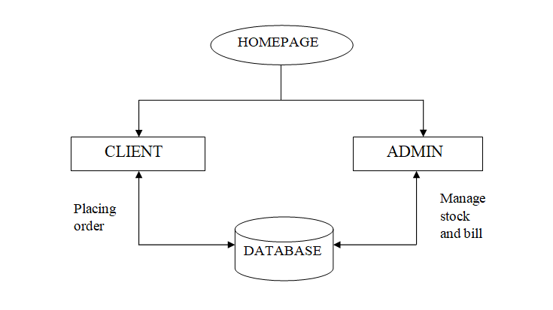
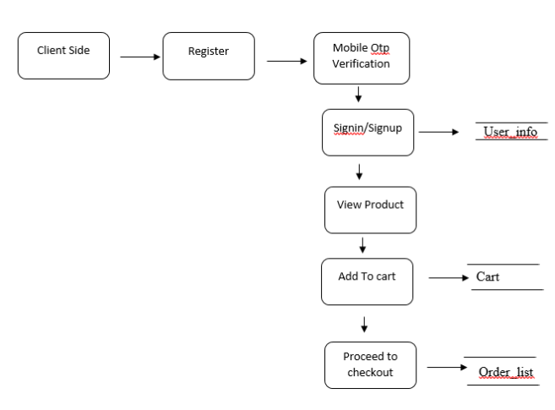
OVERALL DFD

Slide 4
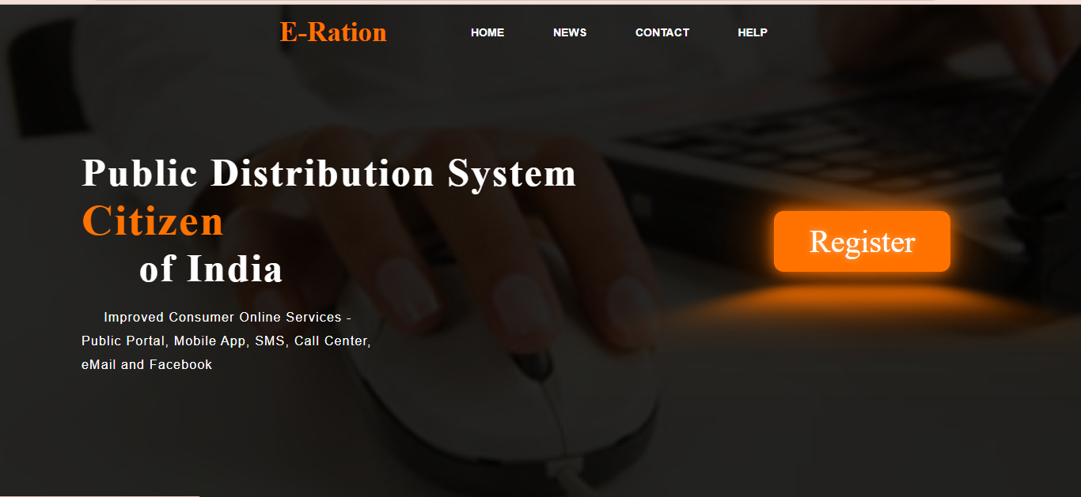
MODULE DISCRIPTION
HOME PAGE
This module contains the basic information about the E-ration . Such as Home, Contact, News, Help, Register form.

Slide 5
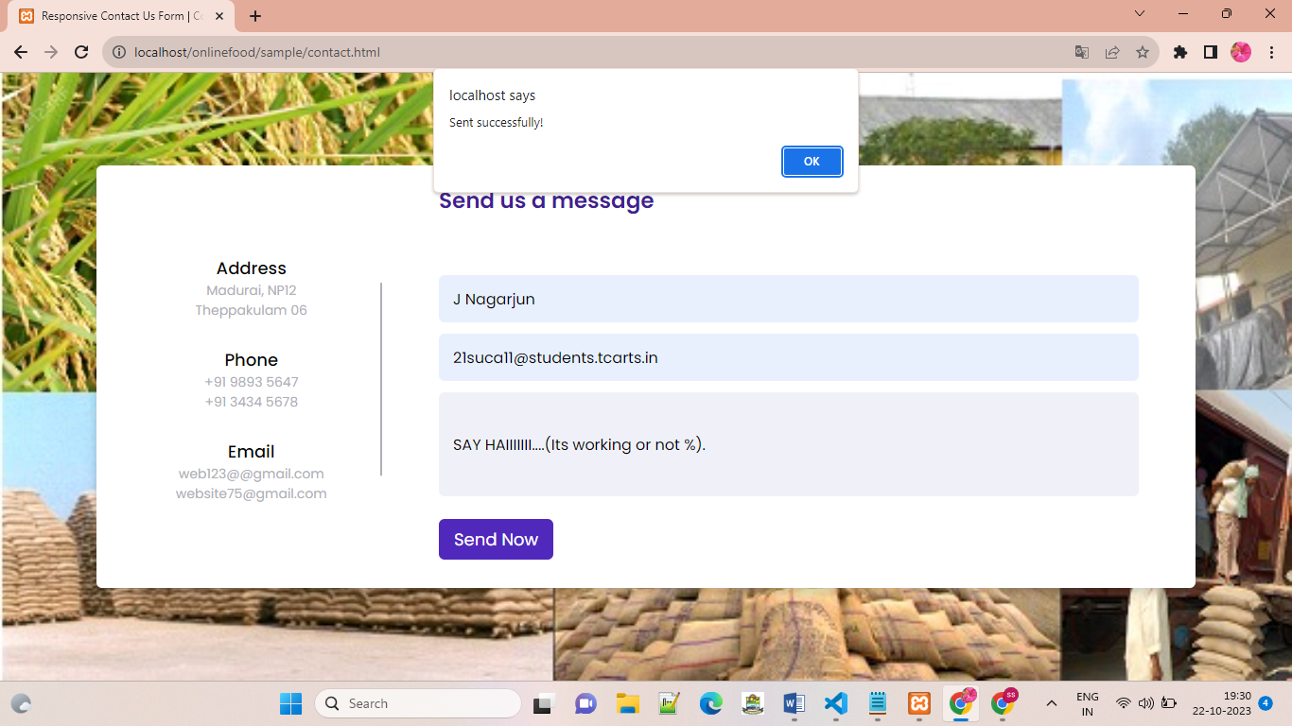
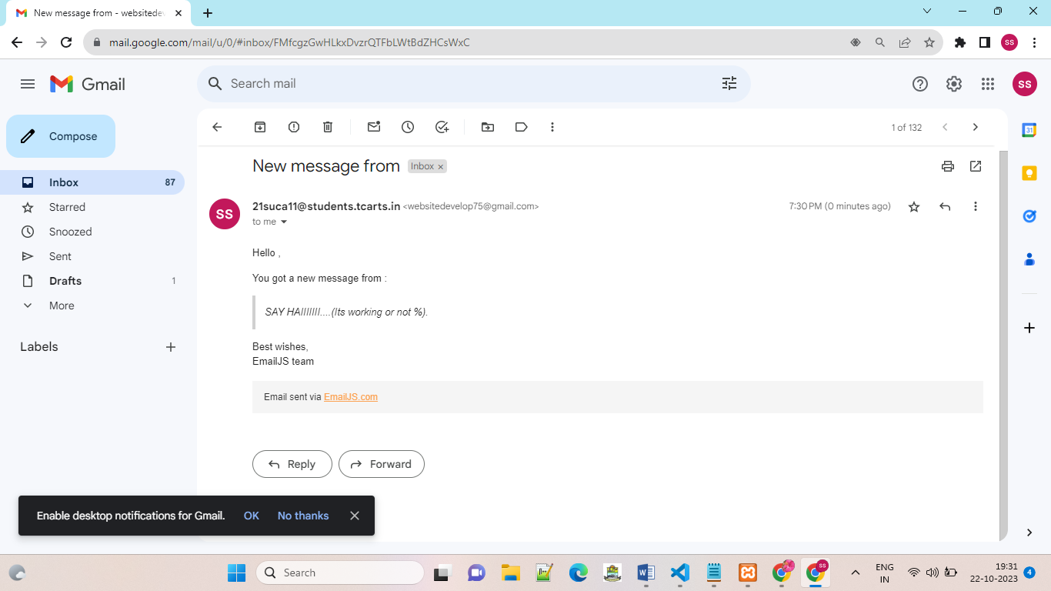
CONTACT
Registered users can contact website owners or website administrators from their place, if users have any query about their product. User can comment about their product and share their feedback about the shop or product quality.

Slide 6
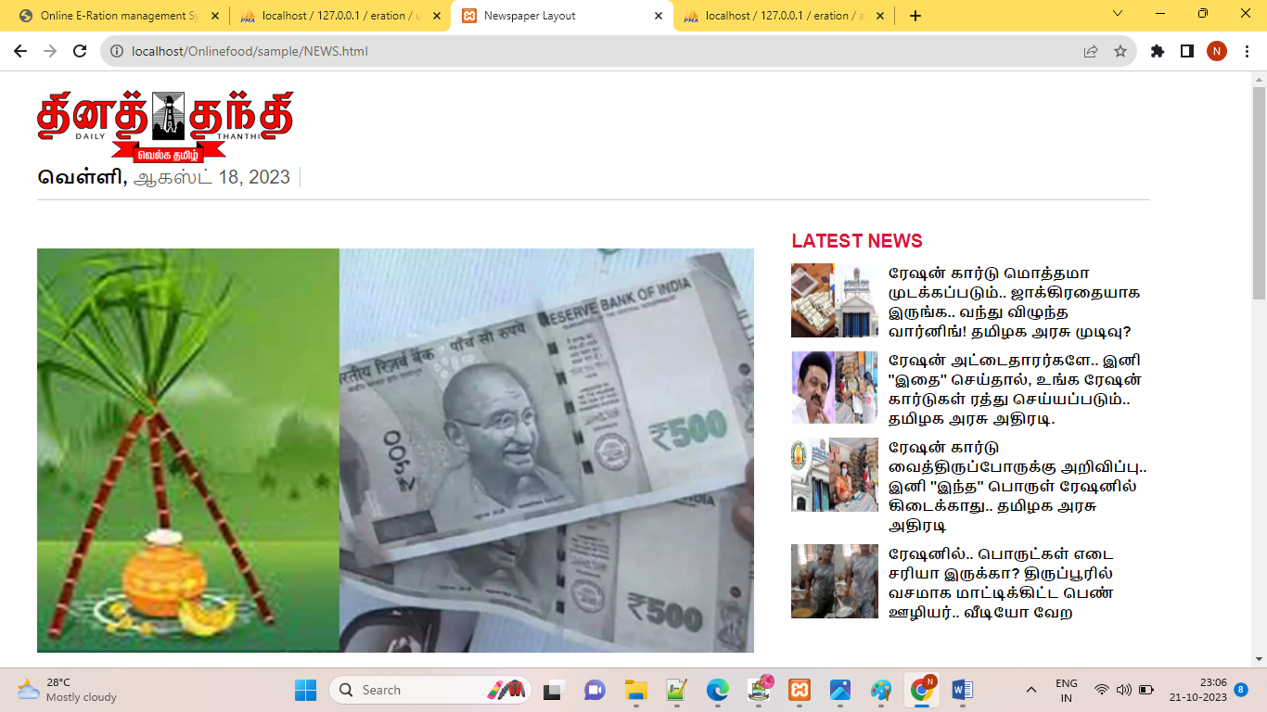
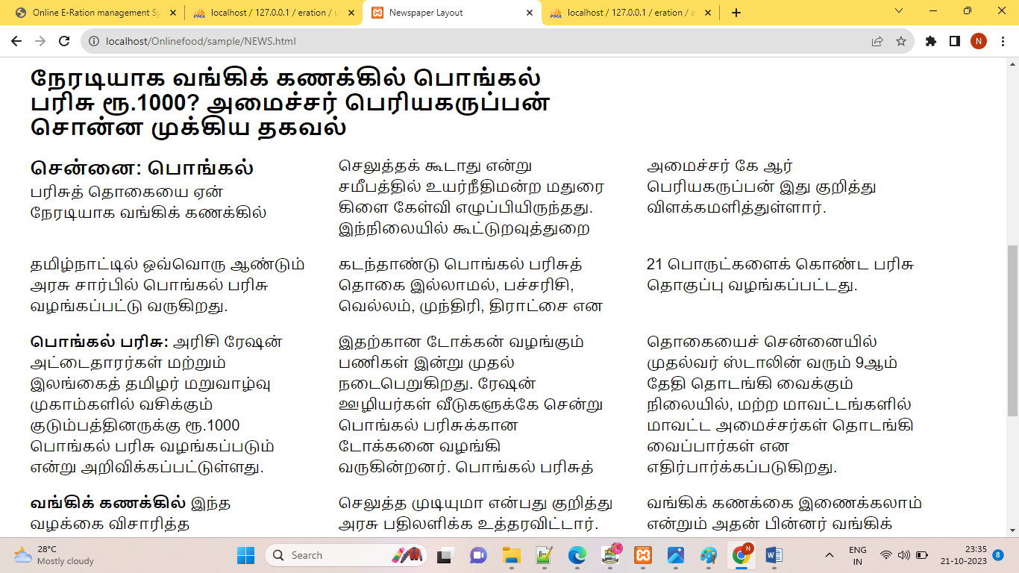
NEWS
We can see News related to ration services announced by the government.

Slide 7
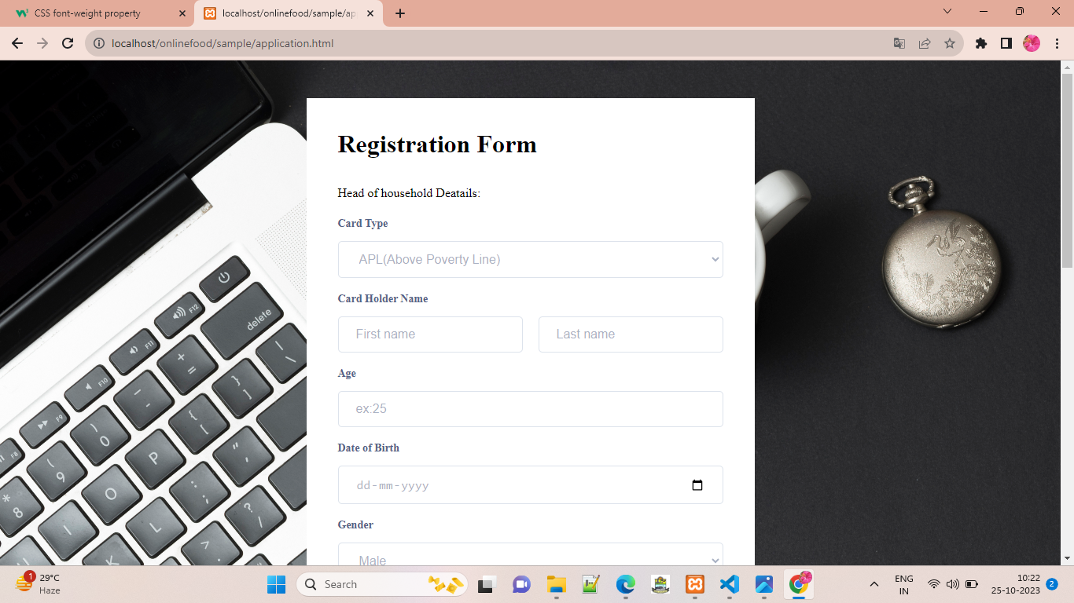
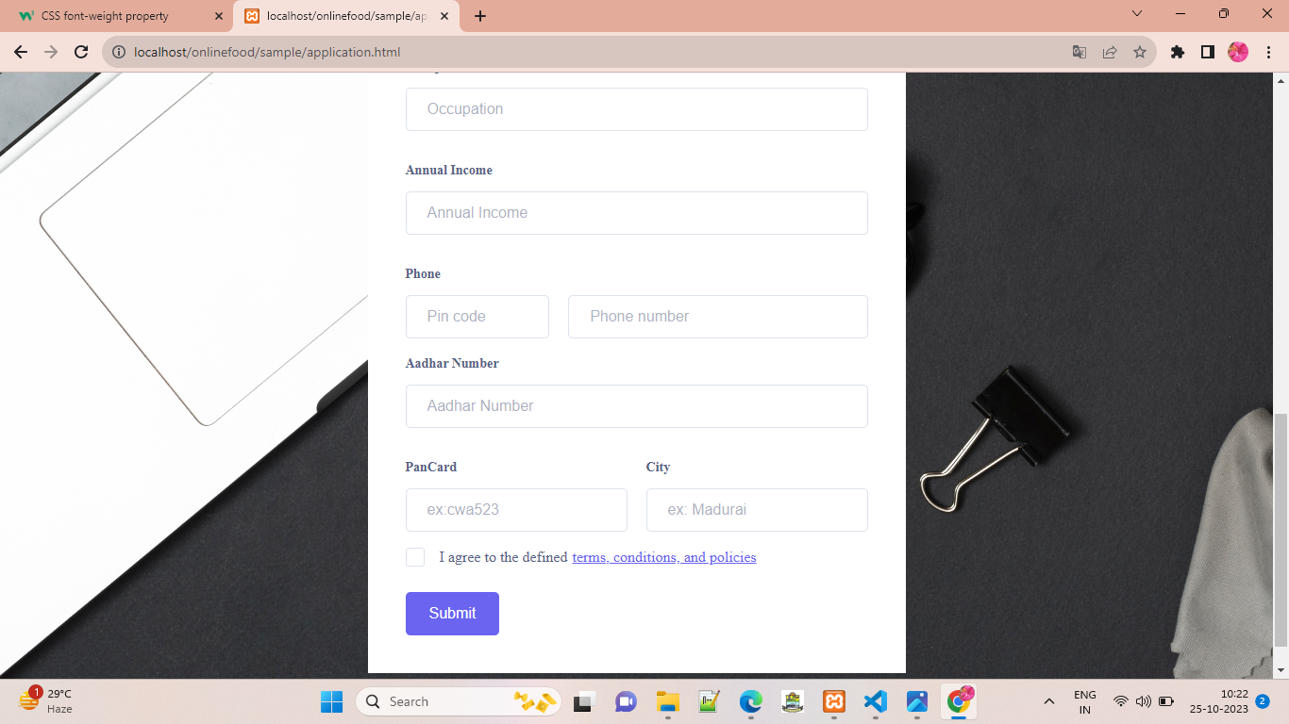
REGISTER FORM FOR USERS
New users can register here. User give their name, email-id and password for the registration. Email-id, password are generated for new individual user to further login process. Only registered users can purchase the products.

Slide 8
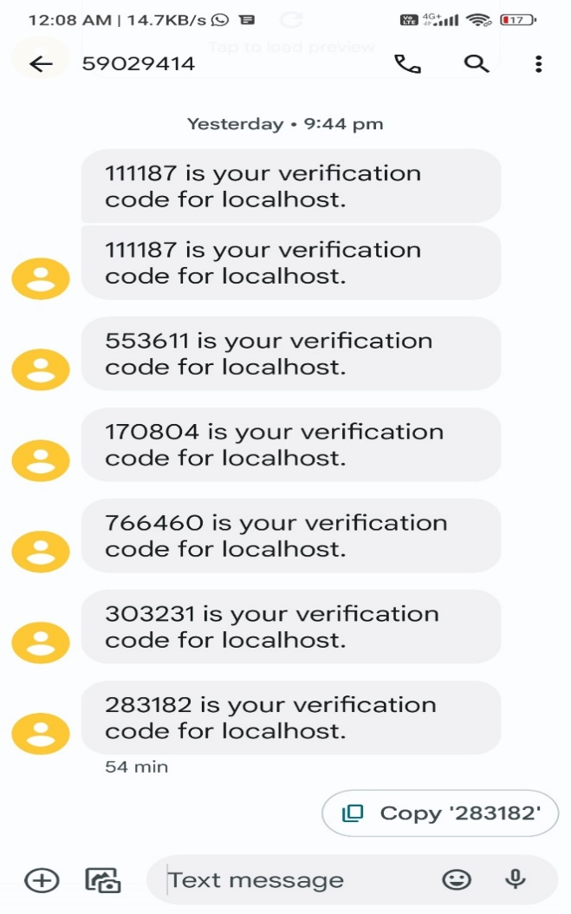
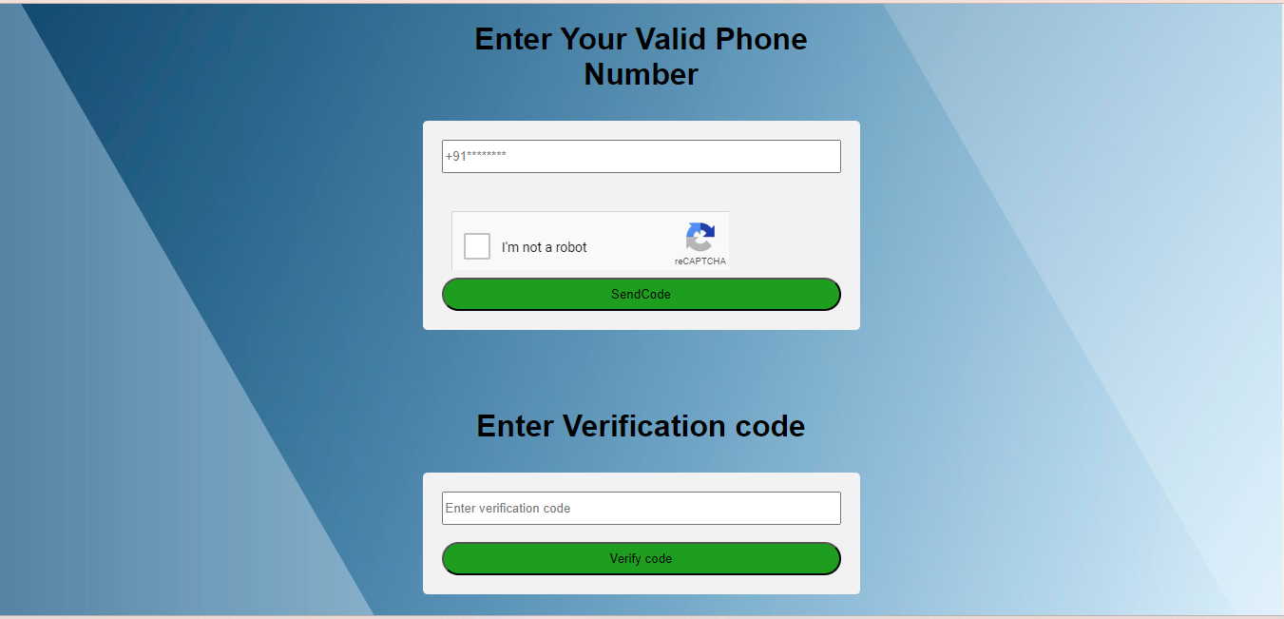
Otp verification
This system check the valid customer by OTP verification and intimated via notification through their mobile.

Slide 9
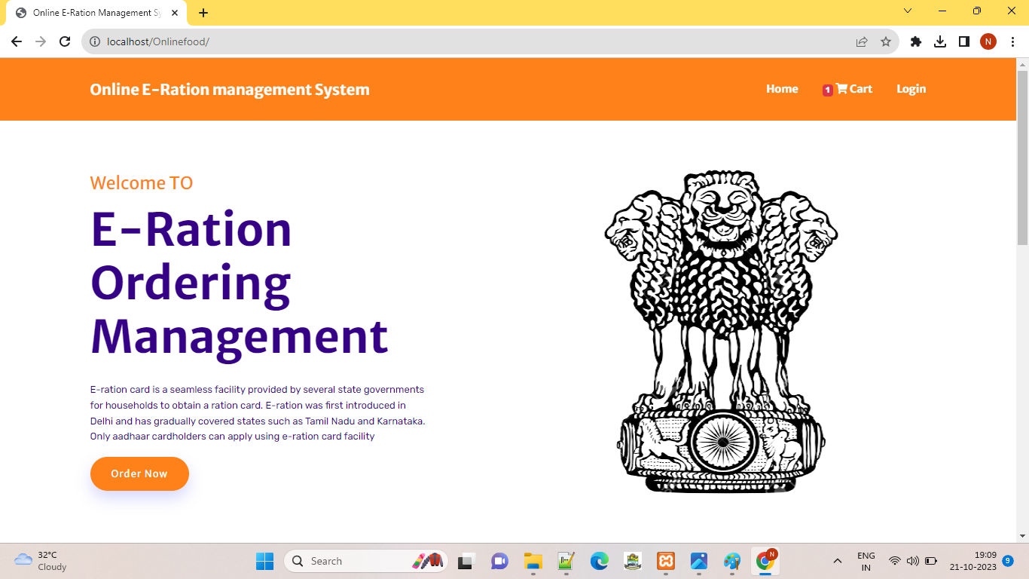
After registration
Users can navigate to the login page after registration.

Slide 10
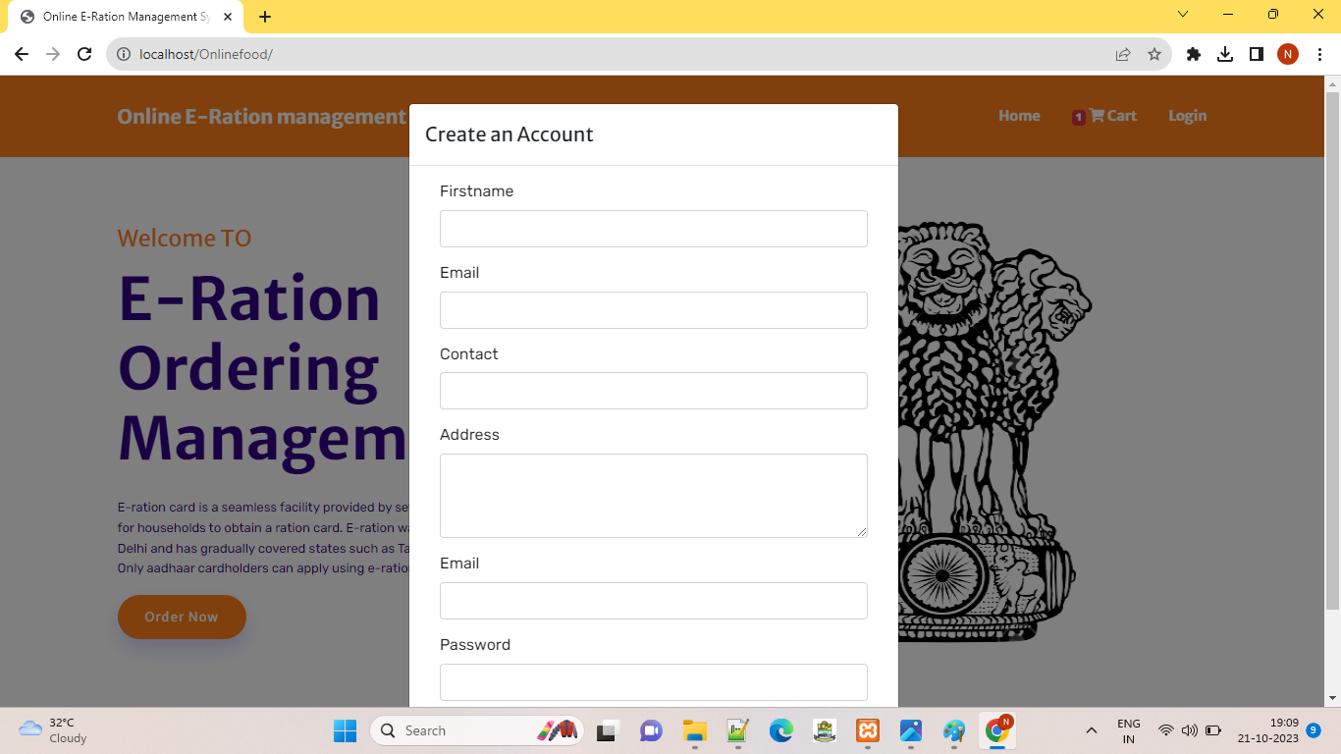
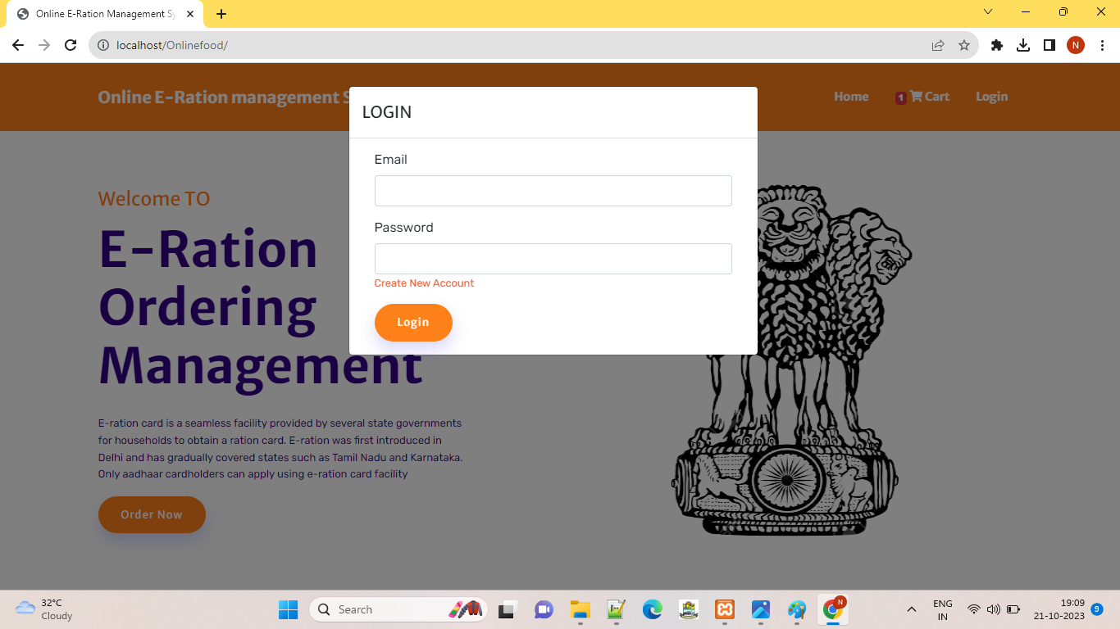

Slide 11
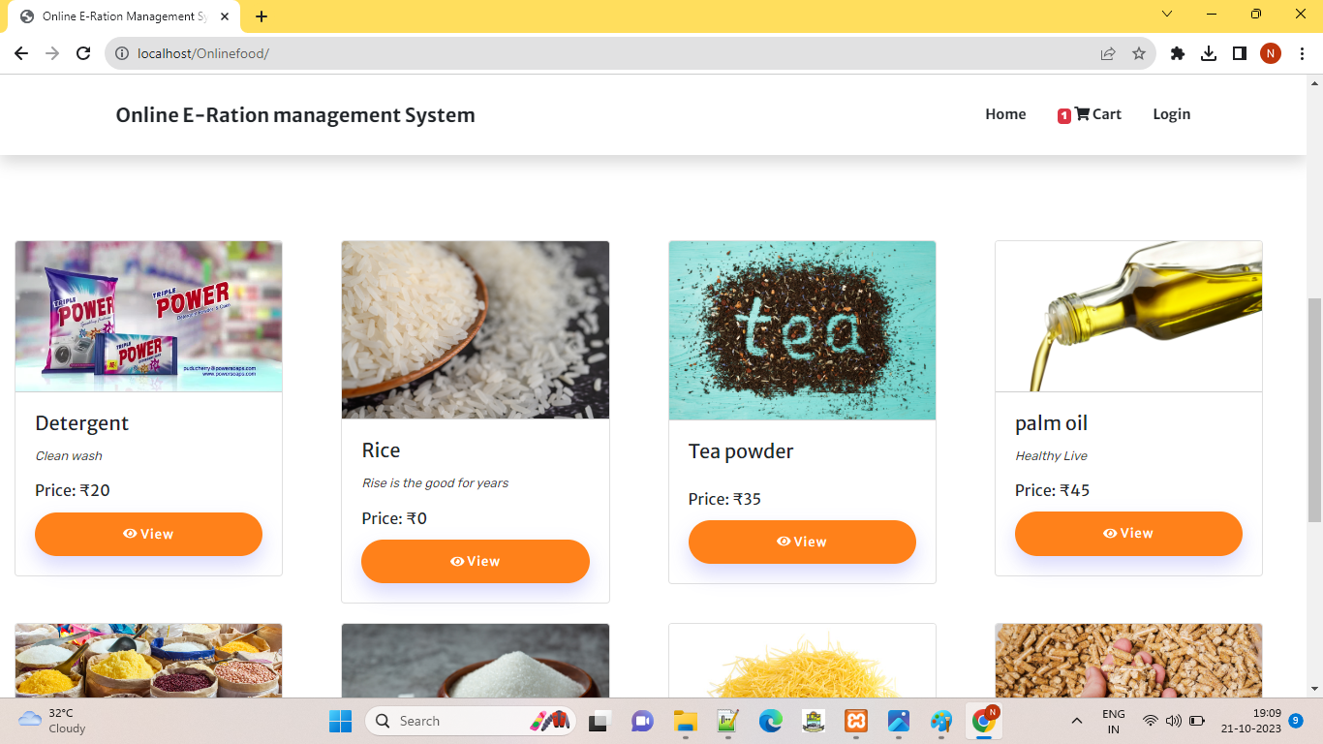
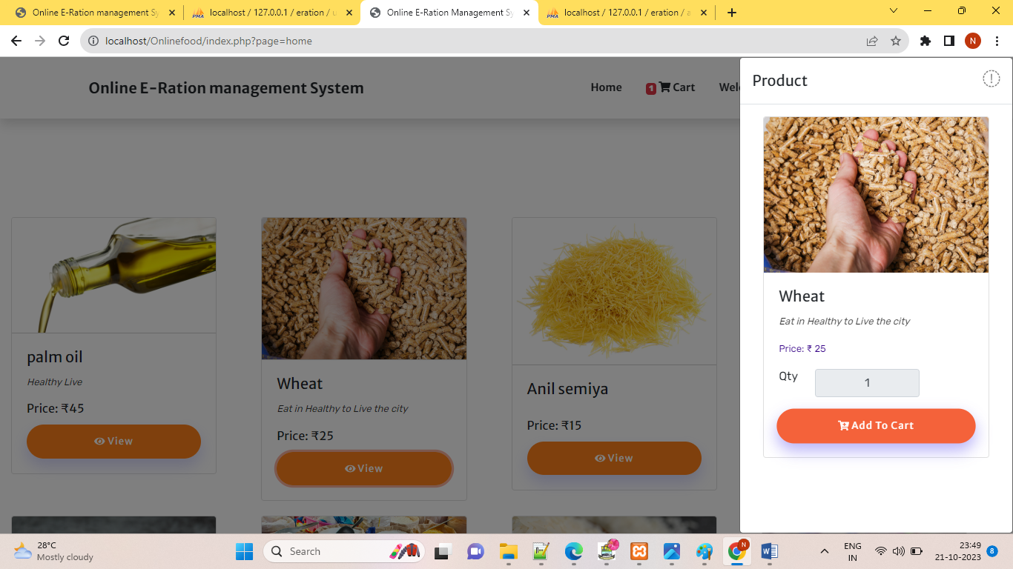
After creating login account we enter into user page. This provides information’s about the product. The user can see all the available products with their price , if the customer wants to get the product he can add it to the cart and purchase it by proceed to check out option..

Slide 12
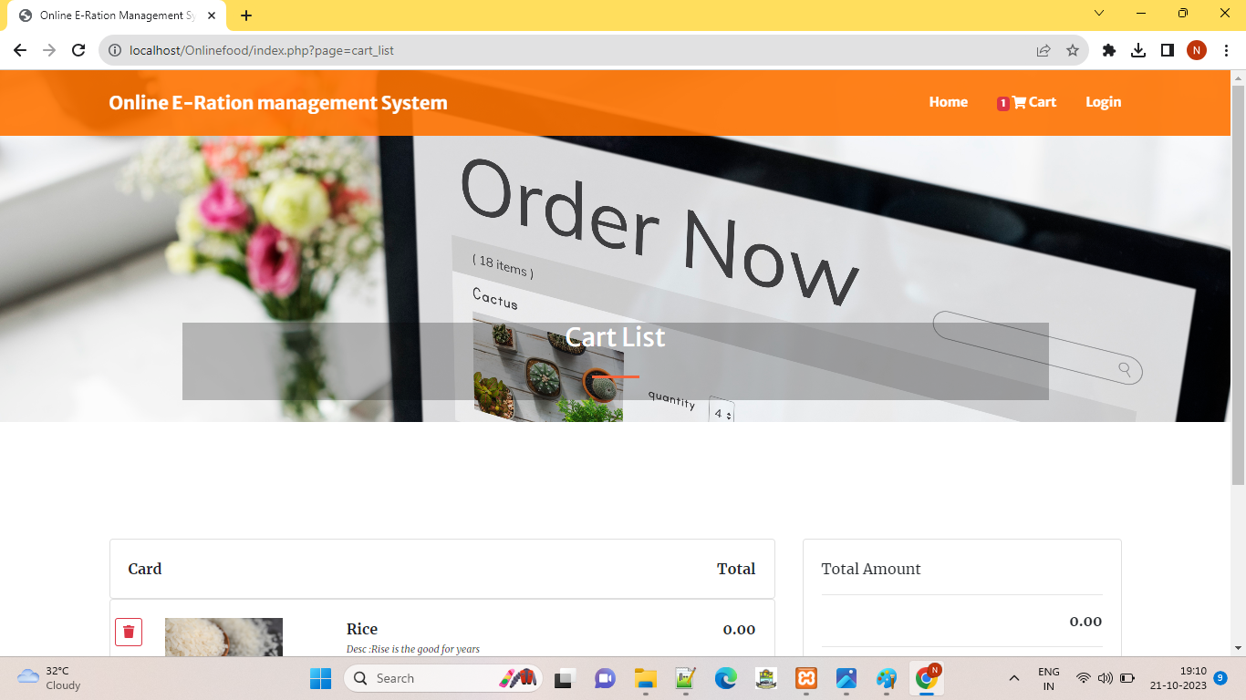
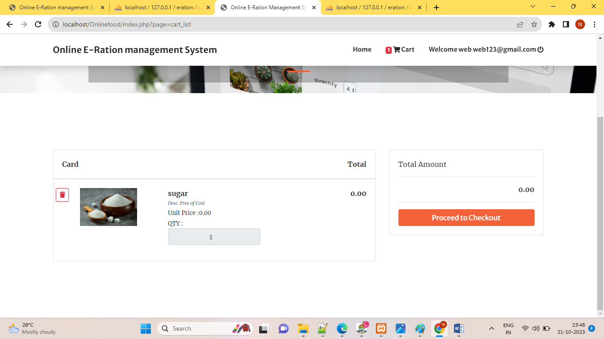

Slide 13
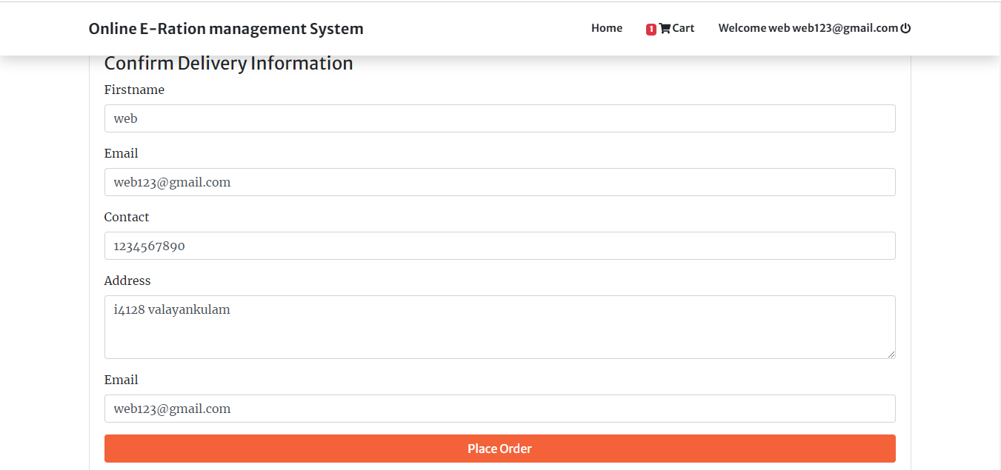
So the placed order is confirmed. The customer get the things after paying the amount as cash on delivery at the ration shop
ADMIN MODULE
The admin can login using their username and password. This admin module is divided to 4 options

Slide 14
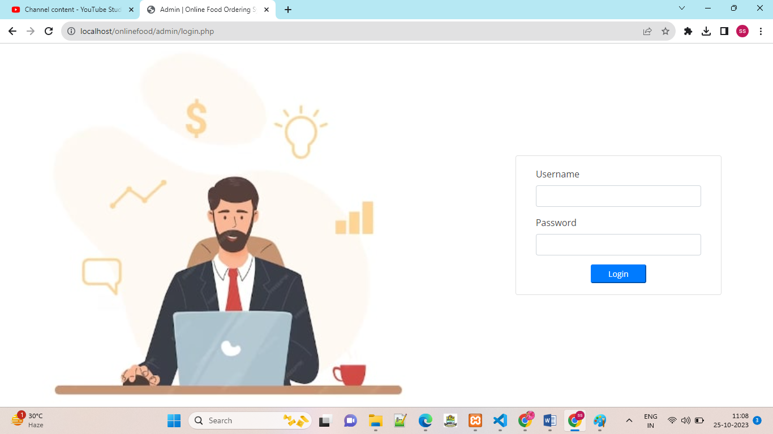
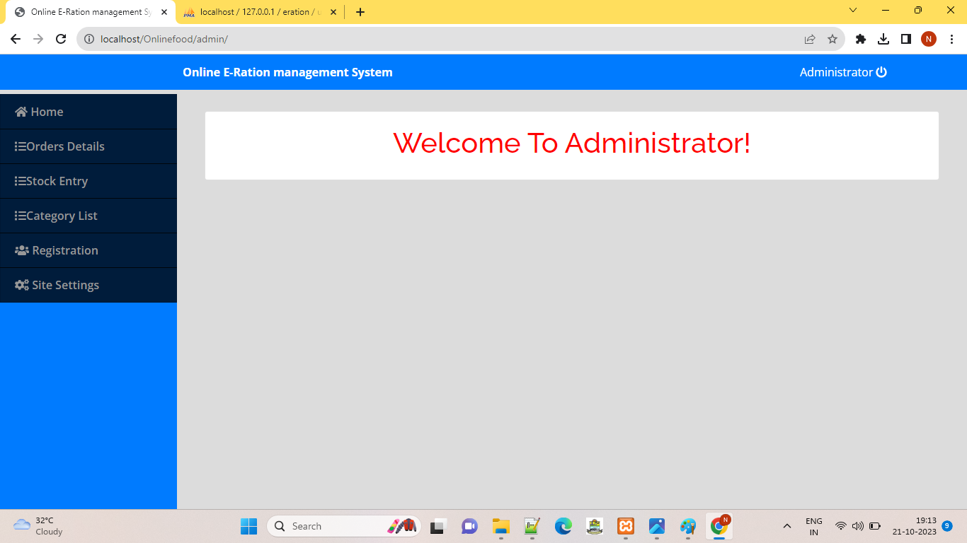

Slide 15
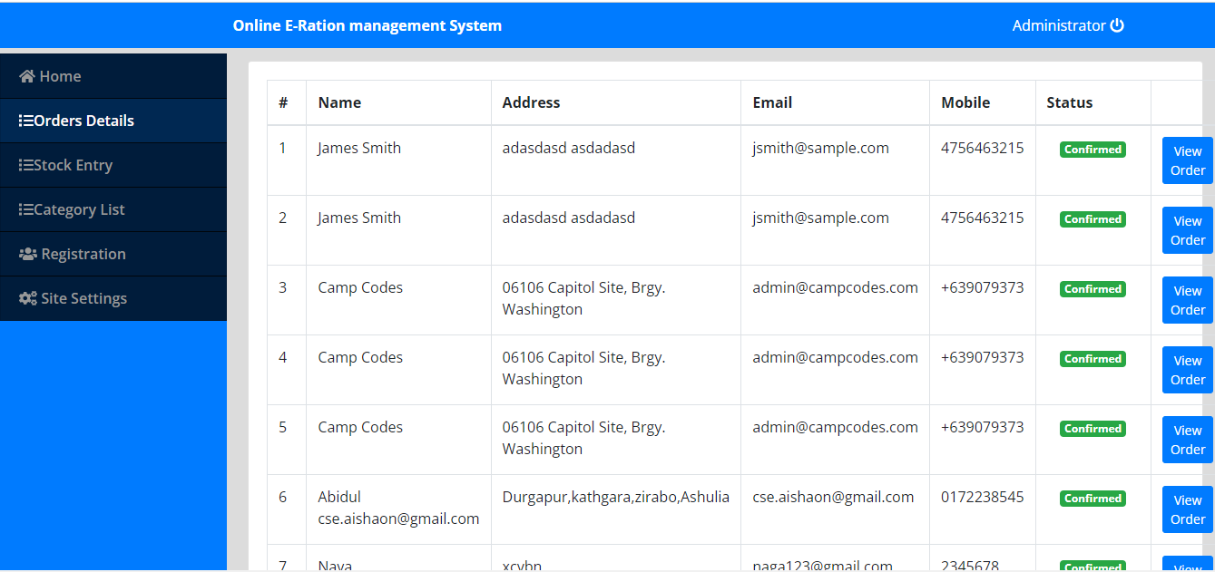
Ordered Details :
This module contains the details about the customers, who the order their products and the details about the orders placed by the customers through online.
This module has the billing option for the admin and it also help the admin to generate the bill to reduce the paperwork. It also contains the view option of invoice bills and the products purchased. Click on view button through conform the order.

Slide 16
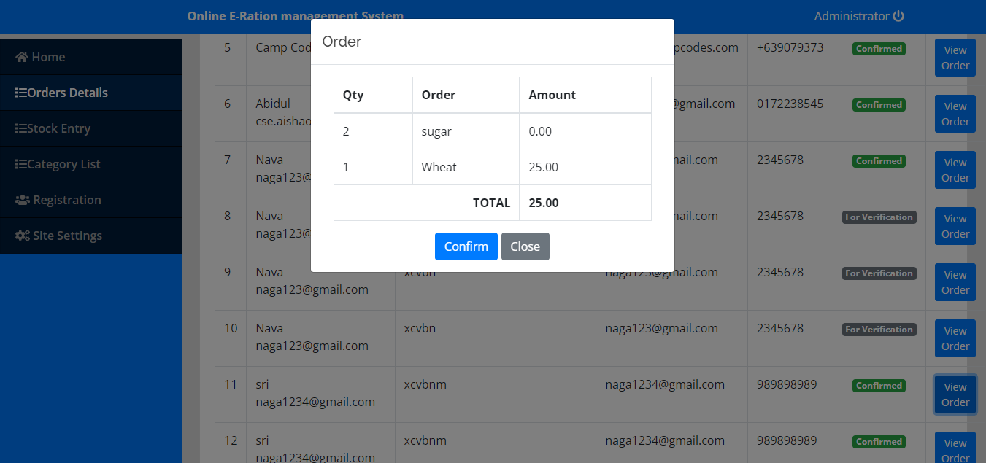
STOCK ENTRY
This module allow the admin to check the availability of the stock and also contains the new entry option of new products.

Slide 17
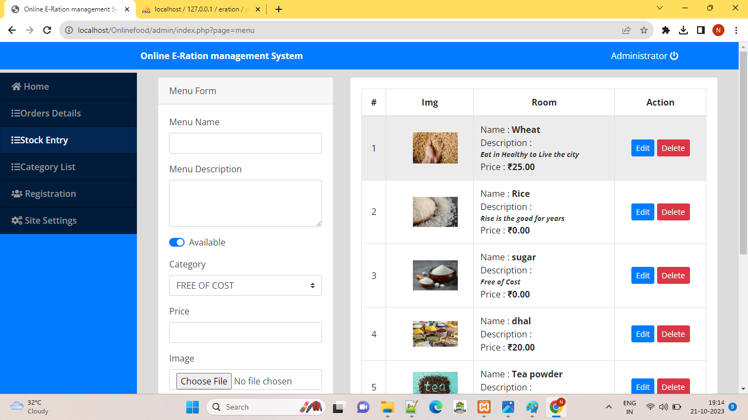
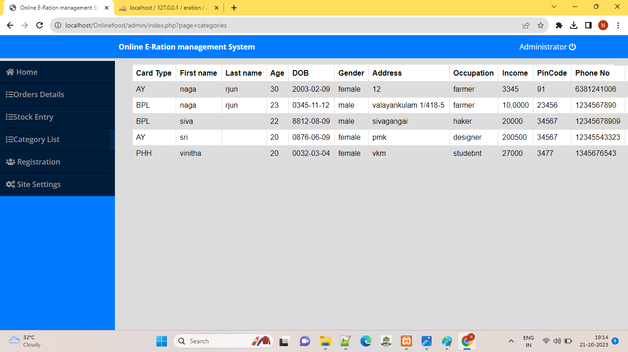
Registration
This module contains the details about the customers to who are all register the application

Slide 18
conclusion
Our project reduce the man power, paper work, time consuming.
Our project makes it more convenient for citizens to register, update their information, and access their entitlements. They can do these tasks online, reducing the need for physical visists to distribution centers.

